Slide 1
14 – Clean Code – SOLID Summary
Based on the CleanCoders videos by Uncle Bob Martin
Rupert Waldron

Slide 2
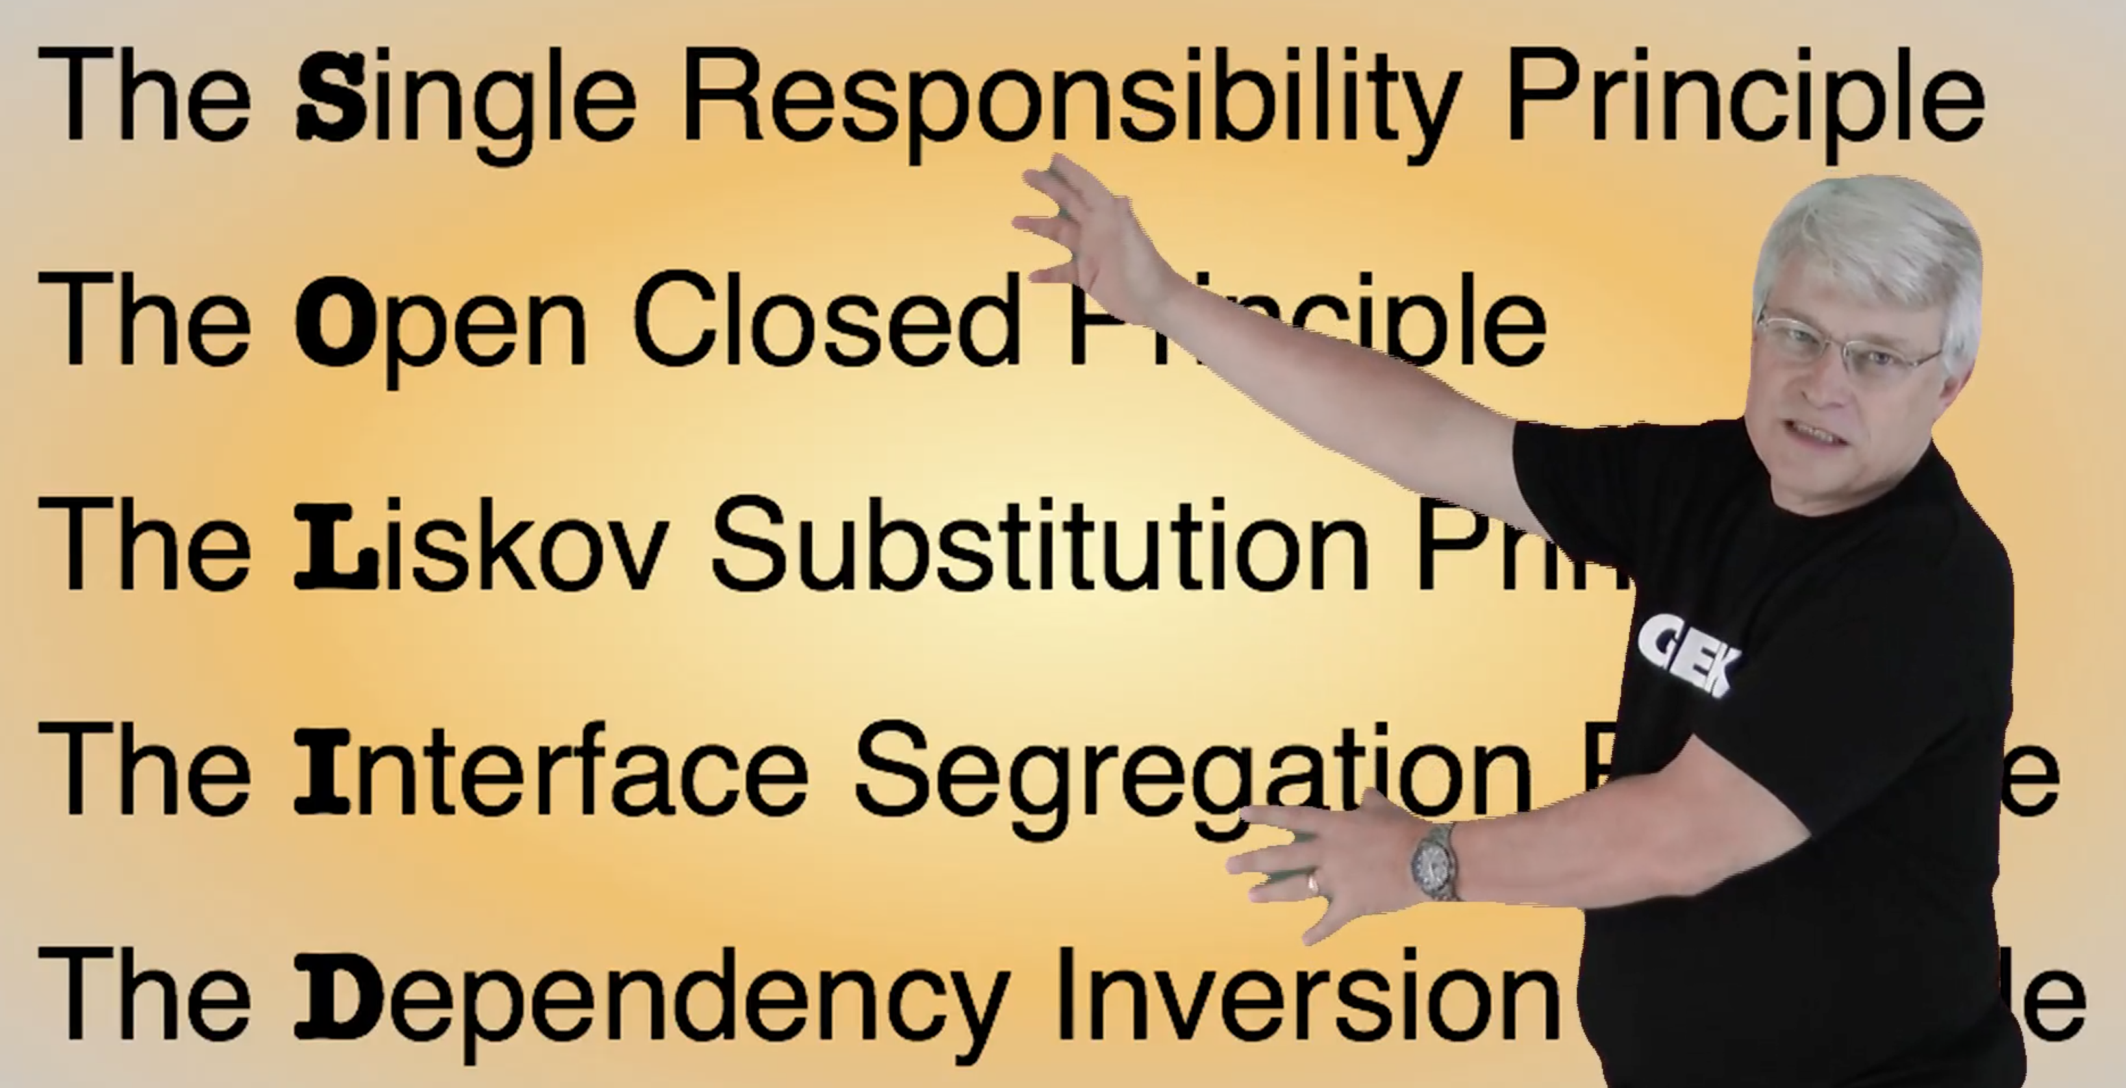
Object Orientated Design is all about Dependency Management
Uncle Bob gives us these dependency management principles that control operations and relationships between classes

Slide 3
Single Responsibility Principle
The SRP states that a module should have one… and only one reason to change. One and only one responsibility. Gather together things that change for the same reasons and separate things that change for different reasons.

Slide 4


Single Responsibility Principle
Who are the actors in this system?
Payroll
Operations
Crud ops
Paying employees
Changing wages
Updating hours
Adding commission
Union
What dues to pay
Service charges
Policy
Update payment methods
Change employee types
Add more employee types

Slide 5
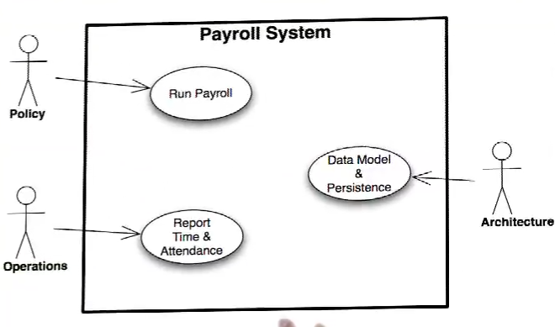
SRP
The SRP states that a module should have one… and only one reason to change. One and only one responsibility. Gather together things that change for the same reasons and separate things that change for different reasons.
First – define who the actors are

Slide 6



Can be worked on as separate modules – only Employee is shared.
PolicyUI
ArchitectUI
OperationsUI
PayPolicy
Gateway
EmployeePrinter
WeeklyPayPolicy
TreeMapGateway
DefaultEmployPrinter
DefaultPayPolicy
HashMapGateway
Employ is now a data structure and knows nothing about the other classes – arrows only point one way.
Employee

Slide 7
Open Close Principle
Objects or entities should be open for extension but closed for modification

Slide 8
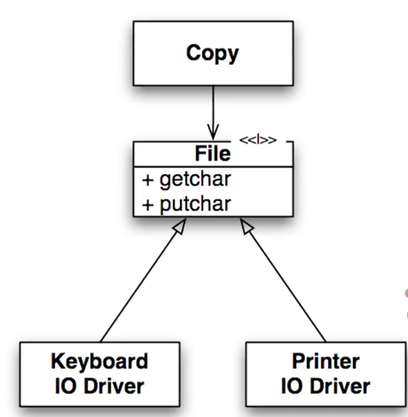
Open Close Principle
OCP means you should be able to change the behaviour of a module but without changing the source code. A good example is the copy module which uses an interface so the copy module no long depends on input and output devices.
To make an OCP module extract the external dependencies and insert an abstract interface which will invert the dependencies. The Copy module now only depends on the new file abstraction.
Flow of Control
We can change the lower level modules without even recompiling the Copy module – we can add new devices without changing the copy module
If you design your system according to the open close principle then you can modify your system by adding new code, and not changing the existing code.

Slide 9
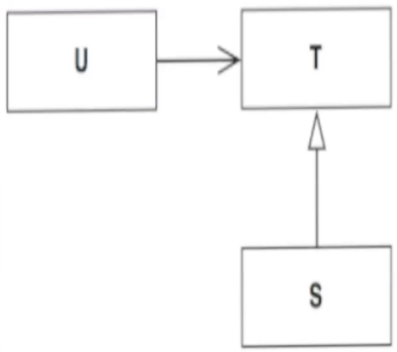
Liskov Substitution Principle
“What is wanted here is something like following substitution property: If for each object O1 of type S there is an object O2 of type T such that for all programs P defined in terms of T, the behaviour of P is unchanged when O1 is substituted for O2 then S is a subtype of T” - Barbara Liskov

Slide 10
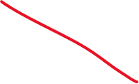


What is a type?
Types are not data structures they are the methods that work with the hidden data. A sub-type is also a collection of methods.
If the sub-type is to be substitutable for its parent it must have the same methods in it as the parent type. But can have different implementations.
public class Point { public double x; public double y; }
A type is a bag of methods
public class Point { public double x; public double y; public void translate(double dx, double dy) { x += dx; y += dy; } }
No operations

Slide 11
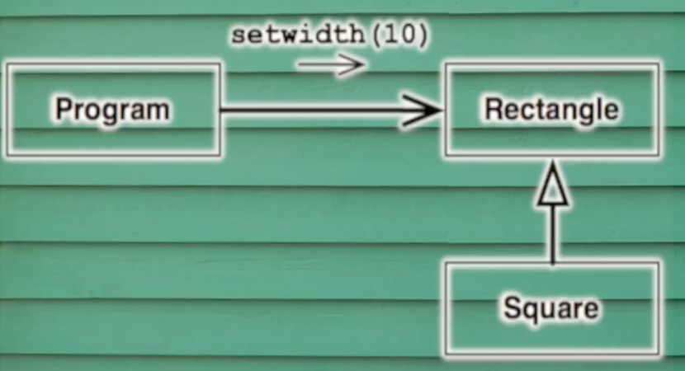
Refused Bequest
The program has the right to expect that when it changes the width of the rectangle the height remains unchanged.
But if a Square gets passed into this module when the height will get changed when the width gets changed.
The program didn’t expect the height to change, this results in undefined behaviour i.e. it works perfectly on your laptop but in production it will crash and delete all the master files… or you will spend weeks debugging a problem that occurs once per day.

Slide 12
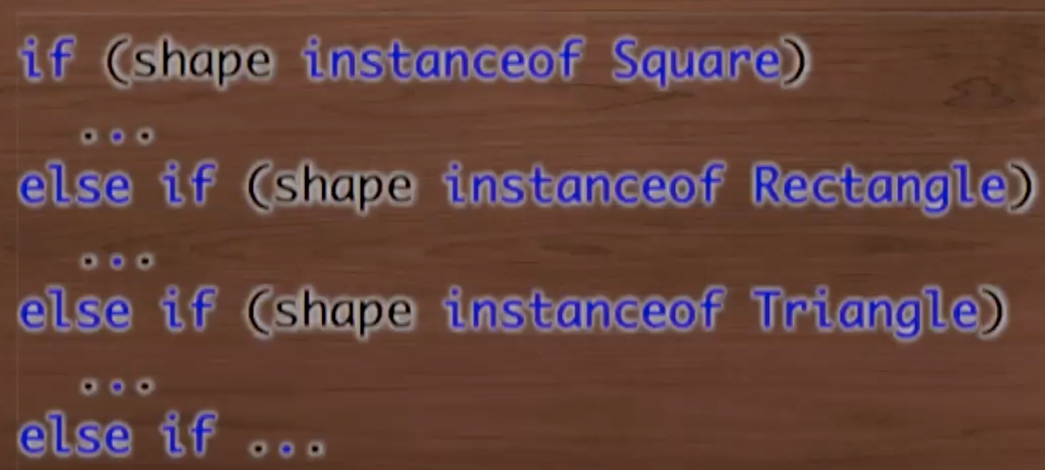
How to spot LSP Violations
If the base class does something, the derived class does should do it to and does it in a way that does not violate the expectations of the callers.
A subtype can do more than it’s parent type, but can never do less. Finding f() {} is often suspicious so is when the derived function just throws an exception.
The presence of the if instanceof statement. Rule… you are allowed to check the type of an instance if you already know what type it is.
If instance of only really becomes a problem if there is an else as well.

Slide 13
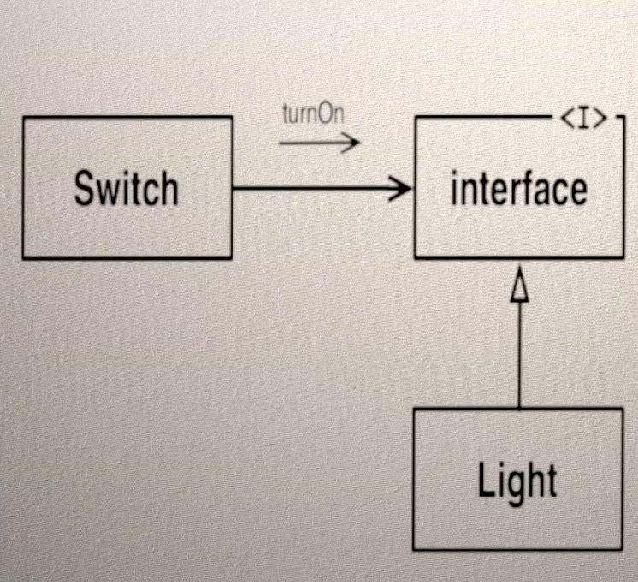
Interface Segregation Principle
A client should never be forced to implement an interface that it doesn’t use, or clients shouldn’t be forced to depend on methods they do not use.
Lets take another look at the light switch.

Slide 14
ISP – Code Smells
Passing in a constructor argument that you don’t actually use.
Building a complex data structure just to run a test
Wire up the webserver and connect to the database just to test a business rule.
Load up jar file to satisfy some part of a library you aren’t going to use.
To write a test to walk through the login process to update a business rule
To call a function you had to call two other functions first but you didn’t know or care what they did.
Don’t force users to depend on things they don’t need to know about.

Slide 15
Dependency Inversion Principle
Entities must depend on abstractions, not on concretions. It states that the high-level module must not depend on the low-level module, but they should depend on abstractions.

Slide 16
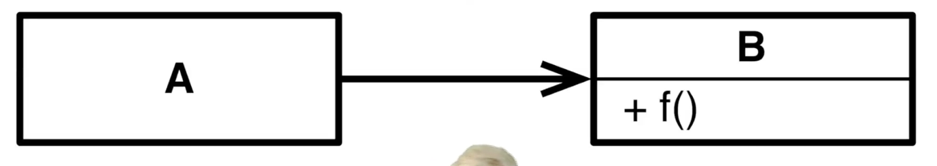
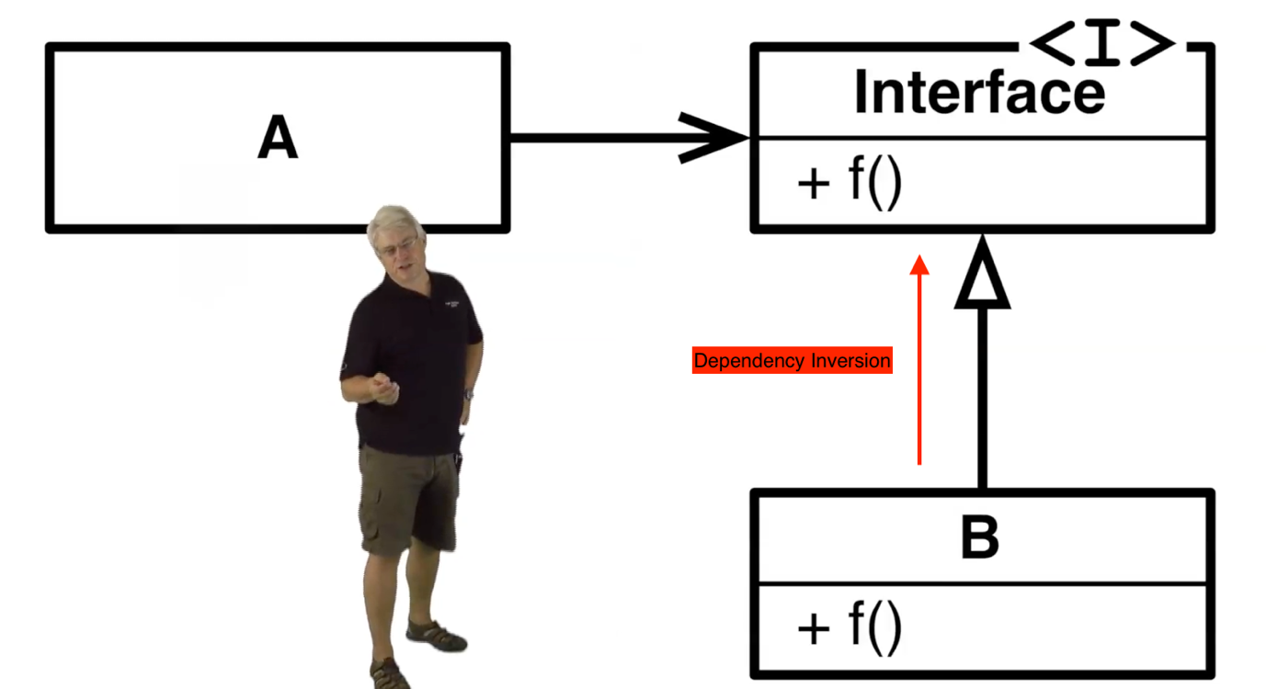

Dependency Inversion
A calls f() on B. Then A has both a runtime and compile time dependency on B
Now use an interface to make the call polymorphic. A uses the interface, B would implement it. A still has a runtime dependency on B, but it doesn’t have a compile time dependency. A and B both have source code dependencies on the interface

Slide 17
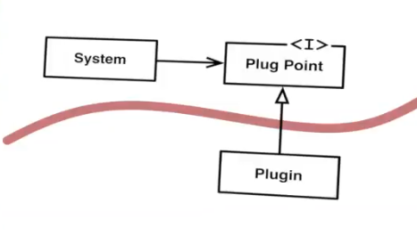
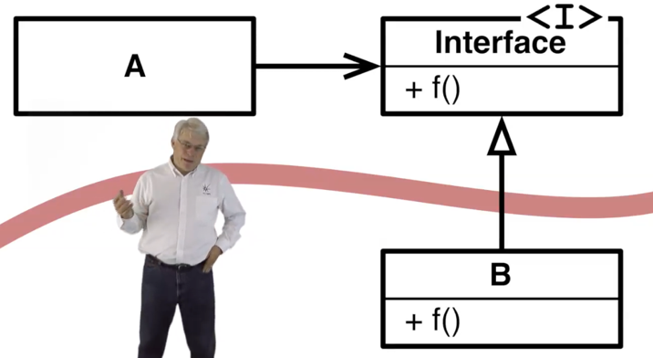
Plugins
We choose where to invert the flow of control so that all dependencies pass in one direction across the boundary.
This is how we create plugins.
A plugin is a module that is anonymously called by another module
Inverting dependencies is the way we create boundaries between software modules

Slide 18
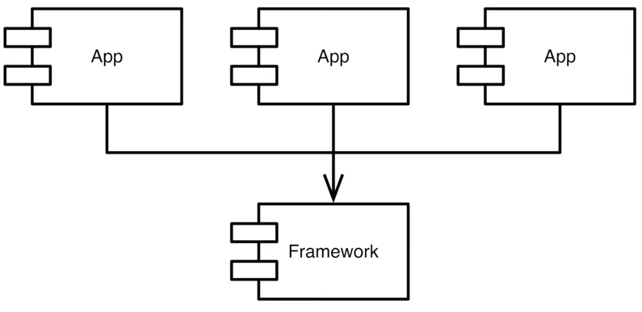
Frameworks
The framework contains the base classes which are implemented by the Apps.
E.g. Spring, Operating Systems with IO Drivers
When designing a framework there should be no dependency by the framework on the application. The high level policy is no longer dependent on low level detail – dependency inversion.
The apps can be develop independently

